Slide 1
Information structure, syntax, pragmatics and other factors in resolving scope ambiguity
Valentina Apresjan
Higher School of Economics
Vinogradov Russian Language Institute
GramLex 2016, Osaka, Japan

Slide 2
Scope ambiguity: considered a phenomenon at the semantics/syntax interface
(1) In my school, every boy liked a girl
Two possible interpretations, depending on the scopes of every boy and a girl:
‘In my school, for every boy, there was a girl he liked’
‘In my school, there was a girl that every boy liked’
Two different scope assignments:
In my school, every boy [liked a girl]
In my school, [every boy liked] a girl

Slide 3
Yet in real communication, we rarely experience difficulties choosing the correct reading
How? We are aided by pragmatic knowledge.
Consider adverb accidentally:
I didn’t cut my finger accidentally =
‘I cut my finger [presupposition]; it was not intentional [assertion]’
It can scope over the verb, with purely accidental agent reading:
(1) The house was accidentally [burnt] in 1947 house fire is normally accidental
It can scope over the complement, with mistaken intentional agent reading:
(2) We accidentally planted [potatoes] planting is normally intentional

Slide 4
Scope ambiguity with universal quantifier and negation
not Y all X =
1. not [Y ] all X ‘all Xs are not Y’
I did not [see] all these people ≈ I saw none of these people
2. not Y [all] X ‘not all Xs are Y’
I did not see [all] these people ≈ I saw some of these people

Slide 5
In many cases, we easily deduce the intended reading contextually
(1) I don’t believe all this bullshit he [tells] me ≈
‘I don’t believe anything of what he tells me’, negation has scope over the verb
(2) I don’t agree with [all he says] but many things sound reasonable ≈ ‘I agree with part of what he says’, negation has scope over the universal quantifier
Question: what pragmatic factors trigger scope disambiguation?

Slide 6
Methods and material: corpus data
Parallel Russian-English and English-Russian corpus, which is a sub-corpus of the Russian National Corpus (ruscorpora.ru).
It counts 24,675,890 words and comprises 19-21 century Russian and English literature (mostly novels), as well as a certain amount of periodicals, in translations.
The search query has been formulated as not + v + all, with the distances set at 3 words.
All contexts that preclude ambiguous readings in principle, such as various idiomatic expressions (not at all, all of it, at all costs, after all, all the more, not only…but also etc.); combinations of all with numerals (all four), deeply embedded clauses (They told them not to stop running until they got all the way back to Tokyo) have been excluded from the search.
Total useful results yielded 147 hits.

Slide 7
Results and discussion
82 readings where not has scope over the universal quantifier:
1. You haven’t told me [all] ≈ ‘You have told me part of what you know’
58 readings where not has scope over the matrix verb or another constituent:
2. such as I don’t [give a heck] about all these idiots ≈ ‘I don’t give a heck about any of these idiots’; I didn’t come all the way from Alabama [to hear you say that] ≈ ‘I came all the way from Alabama for another reason’;
7 ambiguous readings.
→
The actual ambiguity is rare

Slide 8
Factors at play in scope disambiguation
Information structure of the utterance: whether all and the verb are in the Topic or in the Focus
Semantic structure of the utterance: whether all and the verb are presupposed or asserted; related to veridicality
Syntactic structure of the utterance: whether there is a “competing” constituent that can “attract” negation in lieu of the universal quantifier
Pragmatic implicatures: what are the normal pragmatic expectations in the situations described by the utterances

Slide 9
General syntactic restrictions
If all is part of the subject, it prefers constituent negation over sentence negation:
(1) ?All Russians are not gloomy
(2) Not all Russians are gloomy (V. Nabokov, Pale Fire)
All is easily affected by negation if it is a direct complement to the negated verb:
(3) He didn’t like all his students ‘He liked only some of his students’
If all is part of an adjunct, it is less accessible to negation:
He didn’t talk to me all this time ≈ All this time, He didn’t talk to me
‘The entire time, he didn’t talk to me’

Slide 10
Information structure of the utterance
When both all and the matrix verb are part of the Topic, they normally do not fall under negation, which has scope over the focalized constituent, usually a verbal adjunct:
(1) I have not said all this Topic ǁ [in order to annoy you] Focus
‘I have said all this not in order to annoy you’
Without an adjunct a non-negated quantifier reading is not available:
(2) I have not said ǁ [ALL] contrastive Focus
‘I have said not all (that I could)’
Sometimes a target for negation is created by an NPI:
(3) She had not [ONCE] contrastive Focus ǁ thought of him all the morning Topic [Leo Tolstoy. Anna Karenina (parts 5-8) (Constance Garnett, 1911)]
(4) And not [a CREATURE] [contrastive Focus] ǁ coming near us all the evening! [Topic] [Jane Austen. Persuasion (1816)]

Slide 11
All is in the topic, negated matrix verb forms contrastive focus
All constitutes the supposed shared background of the speaker and the hearer; it is presupposed and does not fall into the scope of negation.
However, the matrix verb, which is either non-factive or is placed in a non-veridical context (Giannakidou 1998) is focused and not presupposed.

Slide 12
Negation has scope over the matrix verb, but not over the universal quantifier:
(1) I'm NOT [GOING] all the way to Huntingdon to celebrate the ruby wedding of two [people I have spoken to once for eight seconds since I was three (Helen Fielding, Bridget Jones's Diary (1996)] ≈ ‘All the way to Huntington to celebrate the ruby wedding… [Topic]; I am not going [Focus]’ ≈ ‘I am not going to Huntington at all for the ruby wedding’

Slide 13
Veridical vs. non-veridical contexts
Veridical contexts, on the contrary, license the factual interpretation of the verb, which is conducive to its placement in the presupposition and topic and hence impede its negation:
I have not come all the way to Huntingdon Topic // [to celebrate the ruby wedding of two people I have spoken to once for eight seconds since I was three] Focus ≈ ‘I have come all the way to Huntington, but not for the purpose of celebrating the ruby wedding’

Slide 14
All this, all these: typical contexts for presupposed topical all
Anaphoric expressions used with all aid its interpretation as Topic and given information, thus making it inaccessible for negation; non-veridical context for verb places it in the Focus and creates ‘none’ interpretation
MRS HIGGINS. But, my dear Mr Doolittle, you [need] NOT suffer all this if you are really in earnest ‘any of this’ [Bernard Shaw. Pygmalion (1912)]
I do not [LIKE] to do all this on water ‘any of this’ [Ernest Hemingway. For Whom The Bell Tolls (1940)]
Veridical contexts place the verb in the Topic and “chase” the negation away to adjuncts:
I have not suffered all this Topic || [in vain] Focus [‘all this’]

Slide 15
All is in the Focus, the matrix verb is part of the Topic
The matrix verb and the rest of the sentence are in the topic, while all forms a contrastive focus. The verb is presupposed ,whereas all is asserted and becomes target for negation:
(1) The right rim of the casket had not fallen [ALL] [contrastive Focus] the way to the floor and was still propped partially on its supports [Dan Brown. Angels and Demons (2000)] [‘The rim had fallen part of the way’]
(2) They could not watch [ALL] [contrastive Focus] places [ALWAYS] [contrastive Focus] [Isaac Asimov. The Gods Themselves (1972)] [‘They watched some places some of the time, or all places some of the time, or some places all of the time’]

Slide 16
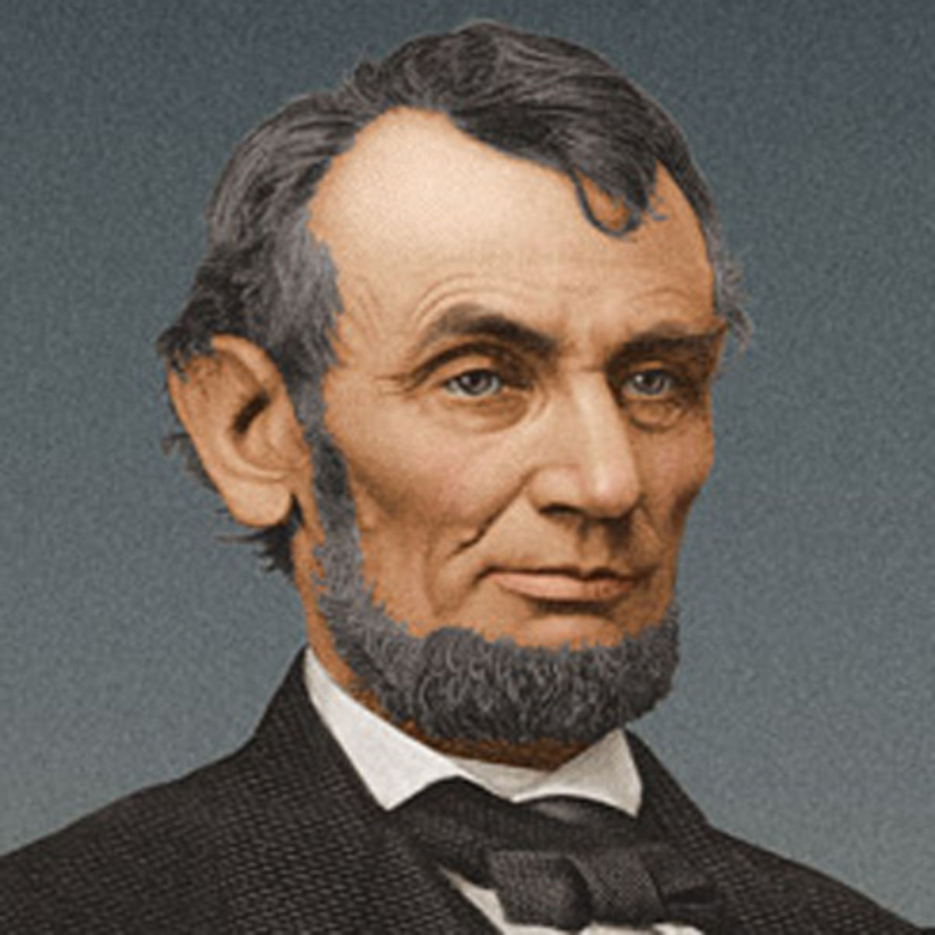
Abraham Lincoln’s legendary phrase falls into this type of information structure
You can fool all the people some of the time, and some of the people all the time, but you cannot fool all the people all the time
Abraham Lincoln

Slide 17
Pragmatic implicatures in time expressions with all
In some cases, the correct scope reading is determined by pragmatic factors, most frequently by conventional pragmatic implicatures.
(1) I haven’t [slept] all night [‘The whole night, I haven’t slept’]
(2) I haven’t slept [all] day [‘I slept only part of the day’]
Different conventional implicatures concerning night and day: people usually sleep the greater part of the night, and do not sleep at all during the day
I slept all night today I slept all day today
I didn’t sleep all night today I didn’t sleep all day today

Slide 18
Sleepless nights are the most frequent supplier of negated verb readings in time expressions with all
Out of 34 time expressions with all, 18 refer to not sleeping all night.
In all cases, negation scopes over the verb and not over all.
There are examples both in original English texts and in the translations of Russian literature:
(1) Elisabeth, who had not [slept] all night, was not yet up. [Vladimir Nabokov. Laughter in the dark (Vladimir Nabokov, 1938-1960)
(2) He is taking a rest; he did not [sleep] all night [Leo Tolstoy. The Awakening (parts 2-3) (William E. Smith, 1900)]

Slide 19
Other time expressions with all
Other time periods with all are more sparsely represented and the split in readings is almost half and half: 9 readings with negated verb and 7 readings with negated all:
(1) I called Tom to report the hideous news that Daniel [had] not [rung] all weekend [Helen Fielding. Bridget Jones's Diary (1996)]
(2) "All this is so, "said another voice," but you are not going to spend –[all your life] in Siberia. [Leo Tolstoy. The Awakening (parts 2-3) (William E. Smith, 1900)]

Slide 20
Other time expressions with all
Pragmatically, phrase (1) with Daniel cannot be interpreted with negated quantifier: informing somebody that Daniel had rung not all weekend but only part of it goes against Grice’s Maxim of Quantity because it can only be interpreted as informative under very unlikely pragmatic circumstances – namely, if someone expected that Daniel would be ringing somebody the entire weekend.
By contrast, (2) with Siberia cannot be interpreted with negated verb: if a person is not already in Siberia or is not at least intending to be there, it makes no sense to say that they are not going to spend their entire life there. Making a statement about somebody not spending their entire life in some place is impossible without some kind of premises, for example, that the person is there at the time of speech; cf. the violation of Relevance Maxim in telling somebody who has never been and never plans to be in Antarctica You are not going to spend all your life in Antarctica.

Slide 21
Implicatures in time expressions with all that interfere with scope reading
For negated verb readings, the implicature is:
One would expect for event V to occur during time period T
He had not [thought] of her all evening; Her bed [had] not [been made] all day; They [had] not [spoken] all week.
For negated quantifier readings, the implicature is:
One would expect for situation V to take place for part of time period T
The concert couldn’t have detained you [all] this time, I don’t want to be explaining myself [all] the time, I simply cannot work [all] the time.

Slide 22
Conclusion
To conclude, the scope of negation over universal quantifier is determined by a range of factors:
The preliminary “sifting” of contests shows the syntactic function of the constituent containing all to be the factor influencing scope interpretation.
The next level of analysis demonstrates the role of semantics and information structure in selecting the plausible reading.
Finally, in a variety of contexts where there is observable structural difference between different readings, scope disambiguation is triggered by pragmatic implicatures and Grice’s cooperative principles.

Slide 23
Literature
Aoun, J., and Y. A. Li. 1989. Scope and Constituency. Linguistic Inquiry 20-2:141-172.
Boguslavsky, I. Sfera dejstvija leksicheskix edinic. Mosow, 1996.
Cooper, R. 1979. Variable binding and Relative Clauses. In F. Guenthner & S.J. Schmidt (eds.), Formal Semantics and Pragmatics for Natural Languages, Reidel, Dordrecht, pp. 131-169
Gil, D. 1982. Quantifier Scope, Linguistic Variation, and natural Language Semantics. L&P 5:421-472.
Hajičova E. Topic-Focus Articulation, Tripartite Structures and Semantic Content, Kluwer, Dordrecht, 1998
Hintikka, J. 1973. Quantifiers vs. quantification theory. Dialectica, 27:329-358. Reprinted in Linguistic Inquiry 5 (1974):153-177.
Ioup, G.L. 1975. The Treatment of Quantifier Scope in a Transformational Grammar. Diss. City U. of New York. Jackendoff, R. 1972. Semantic Interpretation in Generative Grammar. Cambridge, Mass.: MIT Press.
Horn, L. R. 1989. A Natural History of Negation. University of Chicago Press, Chicago. Karttunen, L. & S. Peters. 1980. Interrogative Quantifiers. In: C. Rohrer (ed.), Time, Tense and Quantifiers. Tübingen: Max Niemeyer Verlag.181-205
Kadmon,N., Roberts, C. 1986. Prosody and scope: The role of discourse structure. CLS Proceedings.
Koizumi, Y. 2009. Processing the not-because ambiguity in English: the role of pragmatics and prosody. CUNY thesis.
Kempson, R. M. and A. Cormack. 1981. Ambiguity and quantification. Linguistics and Philosophy, 4:259-309.
Kiss, K. É. 2006. Quantifier Scope Ambiguities. In: The Blackwell Companion to Syntax. Everaert, M. and H. van Riemsdijk (eds). Blackwell. Kratzer, A. 1998. Scope or pseudoscope? Are there wide scope indefinites? In Rothstein, S., editor, Events and Grammar. Kluwer, Dordrecht. Krifka, M. 1989. Nominal reference, temporal constitution and quantification in event semantics. In Bartsch et al. (editors), Semantics and Contextual Expression. Foris: Dordrecht. Kurtzman, H. S., and MacDonald, M. C. 1993. Resolution of quantifier scope ambiguities. Cognition, 48, 243-279.
Pafel, J. 1994, Scope and word order. In J. Jacobs et. Al, (eds) Syntax: an International Handbook of Contemporary Research. De Gruyter, Berlin. 867-888.
Reinhart, T. 1997. Quantifier Scope: How Labour is Divided between QR and Choice Functions, Linguistics and Philosophy 20, 335-397.

